Slide 1
ShareList
Hannan Khan
Yanzhi Wang
Anum Farrukh Khan
Mohammed Furkhan Shaikh
Yu Zhao
Group 6 - Coffee_Code
Iteration 2
04-07-2021
CSE 5324
Software Engineering 1 Analysis, Design, Testing

Slide 2
Agenda
Project Description
Overall Design Approach
Requirements
Use Cases
High Level Use Cases
Use Case Diagram
RUCTM
Increment Matrix
Expanded Use Cases
10. Updated Domain Diagram
11. Sequence Diagrams
12. Updated Task List
13. Design Class Diagram
14. Code Snapshots
15. Summary

Slide 3
Project Description
ShareList is designed to allow users the ability to create, delegate, and track tasks that are shared among users in a group.
Our goal is to allow teams in virtual workspaces the ability to have better collaboration via shared/delegated tasks.
Think of each group as a 'project' in which members contribute towards the tasks they are assigned. It is a similar concept to a Whatsapp group. The messaging is replaced with tasks that can have users assigned to them.
Features include: group admins, group summary reports, database storage, and wireless synchronization of database.

Slide 4
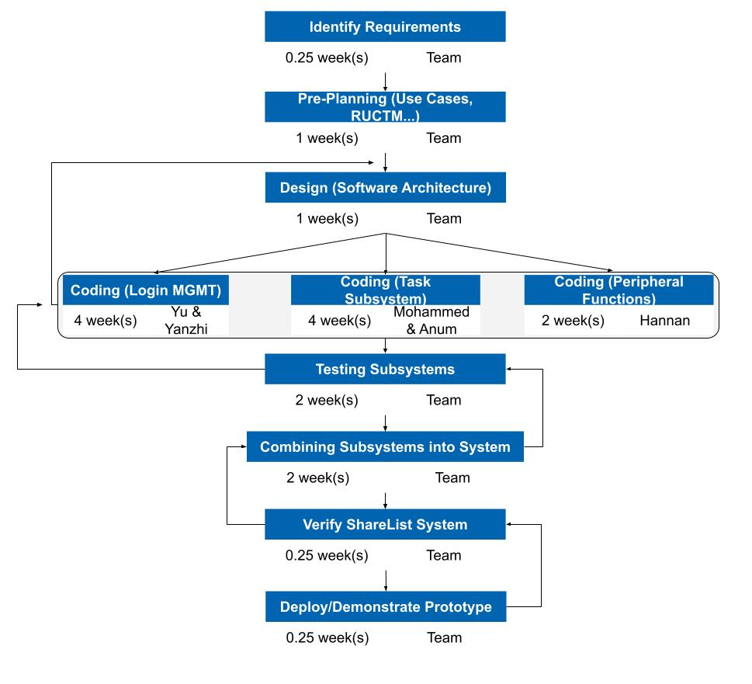
Overall Design Approach

Slide 5
Requirements

Slide 6
Req ID | Req Statement | Line #
R1 | The system shall provide for authenticated login to the ShareList app.
R1.1 | Register. | 40
R1.2 | Login.
R1.3 | Log Off.
R1.4 | Reset password.
R2 | The system shall provide admins the ability to:
R2.1 | Add tasks. | 41,42
R2.2 | Remove tasks.
R2.3 | Edit tasks.
R2.4 | Assign tasks.
R2.5 | Add users to group. | 46,47
R2.6 | Remove users from the group. | 34,35
R2.7 | Add new Admins to group. | 18,47
R2.8 | Delete group | 48,49
R2.9 | Edit group. | 46,47
R3 | The system shall provide users/admins the ability to:
R3.1 | Mark task as completed. | 44,45
R3.2 | Create groups. | 46,47
R4 | The system shall provide the ability to search by keywords. | 43
R5 | The system shall provide tasks the ability to:
R5.1 | Be visible to all members in that group. | 22,23
R5.2 | Have users assigned to it. | 41,42
R5.3 | Have assigned users mark it as completed. | 44,45
R6 | The system shall provide tasks the following properties: start time, completion time, due date, time spent, title, description, users assigned | 50
R7 | The system shall provide users the ability to create groups, and have admin status when they do. | 46,47
R8 | The system shall provide a database used for storing information related to tasks, groups, users. | 59
R9 | The system shall provide wireless resources used for syncing between each user's device and the database. | 60
R10 | The system shall provide a group summary function, which will accomplish: | 50
R10.1 | Calculating and reporting the tasks completed. | 52
R10.2 | Calculating and reporting the in-progress tasks. | 53
R10.3 | Calculating and reporting the tasks not completed by due date. | 54

Slide 7
Use Cases
Use Case # | Use Case Name
UC1 | Login
UC1.1 | Register.
UC1.2 | Login.
UC1.3 | Log Off.
UC1.4 | Reset password.
UC2 | Manage task
UC2.1 | Add tasks.
UC2.2 | Remove tasks.
UC2.3 | Edit tasks.
UC2.4 | Assign tasks.
UC3 | Manage group
UC3.1 | Add users.
UC3.2 | Remove users.
UC3.3 | Add admins.
UC3.4 | Delete groups
UC3.5 | Edit groups.
UC4 | Mark task as completed
UC5 | Create groups.
UC6 | Search by keywords.
UC7 | Generate summary

Slide 8
High Level Use Cases
UC 1.1: Register
- TUCBW the user entering required details and clicking the register button.
- TUCEW the user being registered successfully.
UC 1.2: Login
- TUCBW the user enters the username and password.
- TUCEW the user successfully logs in and can see the home page.
UC 1.3: Log Off
- TUCBW the user clicks on the logout button.
- TUCEW the user is successfully logged out and can see the login page.
UC 1.4: Reset Password
- TUCBW the user clicks on the reset password option.
- TUCEW the password of the user is changed.
UC 2.1: Add Tasks
- TUCBW the admin clicking on the “Add Tasks” option.
- TUCEW the admin adding the task successfully and can see the added tasks.
UC 2.2: Remove Tasks
- TUCBW the admin clicking the “Remove Task” option.
- TUCEW the admin removing the task successfully.
UC 2.3: Edit Tasks
- TUCBW the admin clicking on the “Edit Task” option and making the necessary changes.
- TUCEW the admin being able to see the changes made to the respective tasks.
UC 2.4: Assign Tasks
- TUCBW the Admin assigning the task to particular users.
- TUCEW the users get assigned new tasks.
UC 3.1: Add users
- TUCBW the admin clicking on the add member option.
- TUCEW the user being added to the selected group.
UC 3.2: Remove users
- TUCBW the admin selecting a user to be removed from the group.
- TUCEW the user is no longer a member of the group.
UC 3.3: Add admins
- TUCBW the admin selecting a member to be an admin.
- TUCEW the selected user being the admin for the group.
UC 3.4: Delete Group
- TUCBW the admin selecting the delete group option.
- TUCEW the group, related tasks and users, being removed from the records.
UC 3.5: Edit Group
- TUCBW the admin selecting the edit group option.
- TUCEW the group information is updated by the admin.
UC 4: Mark task as completed
- TUCBW the users selecting their assigned tasks to be marked complete.
- TUCEW the tasks information being updated by the users.
UC 5: Create Group
- TUCBW the user selecting the create group option.
- TUCEW new group being created with the user as the admin of the group.
UC 6: Search by keywords
- TUCBW the user clicking on the search option.
- TUCEW the search results being returned to the user.
UC 7: Generate summary
- TUCBW the user selecting the generate summary option.
- TUCEW the summary of tasks and reports being displayed to the user.

Slide 9
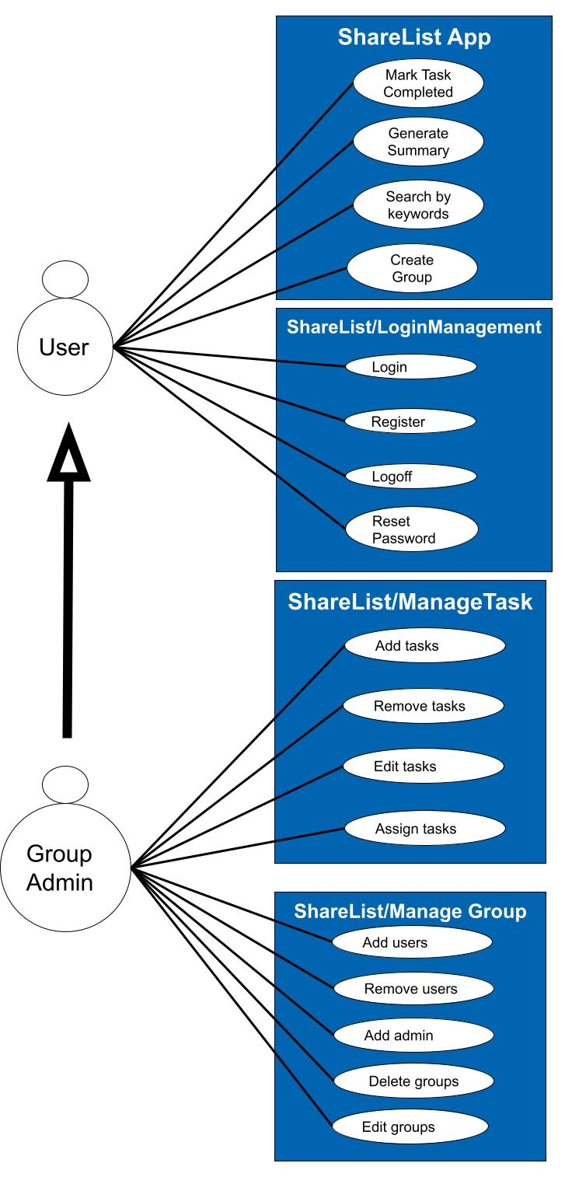
Use Case Diagram

Slide 10
RUCTM
Req ID | Priority Weight | UC 1 | UC 1.1 | UC 1.2 | UC 1.3 | UC 1.4 | UC 2 | UC 2.1 | UC 2.2 | UC 2.3 | UC 2.4 | UC 3 | UC 3.1 | UC 3.2 | UC 3.3 | UC 3.4 | UC 3.5 | UC 4 | UC 5 | UC 6 | UC 7
R1 | 3 | X
R1.1 |  |  | X
R1.2 |  |  |  | X
R1.3 |  |  |  |  | X
R1.4 |  |  |  |  |  | X
R2 | 1 |  |  |  |  |  | X
R2.1 |  |  |  |  |  |  |  | X
R2.2 |  |  |  |  |  |  |  |  | X
R2.3 |  |  |  |  |  |  |  |  |  | X
R2.4 |  |  |  |  |  |  |  |  |  |  | X
R2.5 |  |  |  |  |  |  |  |  |  |  |  |  | X
R2.6 |  |  |  |  |  |  |  |  |  |  |  |  |  | X
R2.7 |  |  |  |  |  |  |  |  |  |  |  |  |  |  | X
R2.8 |  |  |  |  |  |  |  |  |  |  |  |  |  |  |  | X
R2.9 |  |  |  |  |  |  |  |  |  |  |  |  |  |  |  |  | X
R3
R3.1 |  |  |  |  |  |  |  |  |  |  |  |  |  |  |  |  |  | X
R3.2 |  |  |  |  |  |  |  |  |  |  |  |  |  |  |  |  |  |  | X
R4 | 6 |  |  |  |  |  |  |  |  |  |  |  |  |  |  |  |  |  |  | X

Slide 11
RUCTM
Req ID | Priority Weight | UC 1 | UC 1.1 | UC 1.2 | UC 1.3 | UC 1.4 | UC 2 | UC 2.1 | UC 2.2 | UC 2.3 | UC 2.4 | UC 3 | UC 3.1 | UC 3.2 | UC 3.3 | UC 3.4 | UC 3.5 | UC 4 | UC 5 | UC 6 | UC 7
R5 | 1 |  |  |  |  |  | X
R5.1 |  |  |  |  |  |  |  | X
R5.2 |  |  |  |  |  |  |  |  | X
R5.3 |  |  |  |  |  |  |  |  |  | X
R6
R7 | 1 |  |  |  |  |  |  |  |  |  |  | X
R8 | 2
R9 | 4
R10 | 5 |  |  |  |  |  |  |  |  |  |  |  |  |  |  |  |  |  |  |  | X
R10.1 |  |  |  |  |  |  |  |  |  |  |  |  |  |  |  |  |  |  |  |  | X
R10.2 |  |  |  |  |  |  |  |  |  |  |  |  |  |  |  |  |  |  |  |  | X
R10.3 |  |  |  |  |  |  |  |  |  |  |  |  |  |  |  |  |  |  |  |  | X
Score |  | 3 | 3 | 3 | 3 | 3 | 2 | 2 | 2 | 2 | 1 | 1 | 1 | 1 | 1 | 1 | 1 | 1 | 1 | 7 | 24
Legend | 1 is highest priority. | Work 1 first.

Slide 12
Increment Matrix
Use Case # | Priority | Effort (Person-weeks) | Depends on | Iteration 1 (03/12) | Iteration 2 (04/09) | Iteration 3 (05/03)
UC1 | 3 |  | None
UC1.1 |  | 6 |  |  | 6
UC1.2 |  | 6 |  |  | 6
UC1.3 |  | 6 |  |  | 6
UC1.4 |  | 6 |  |  |  | 6
UC2 | 2 |  | None
UC2.1 |  | 2 |  | 2
UC2.2 |  | 2 |  |  |  | 2
UC2.3 |  | 2 |  |  | 2
UC2.4 | 1 | 3 |  |  | 3
UC3 |  |  | UC 1
UC3.1 |  | 4 |  |  | 4
UC3.2 |  | 4 |  |  | 4
UC3.3 |  | 4 |  |  |  | 4
UC3.4 |  | 4 |  |  |  | 4
UC3.5 |  | 4 |  |  |  | 4
UC4 |  | 3 | UC 2 |  | 3
UC5 |  | 4 | UC 3 |  | 4
UC6 | 5 | 2 | UC 2 |  | 2
UC7 | 4 | 1 |  |  |  | 2
Total Effort |  | 63 |  | 2 | 40 | 22
1 PW = 5 hrs |  |  |  | 10 | 200 | 110

Slide 13
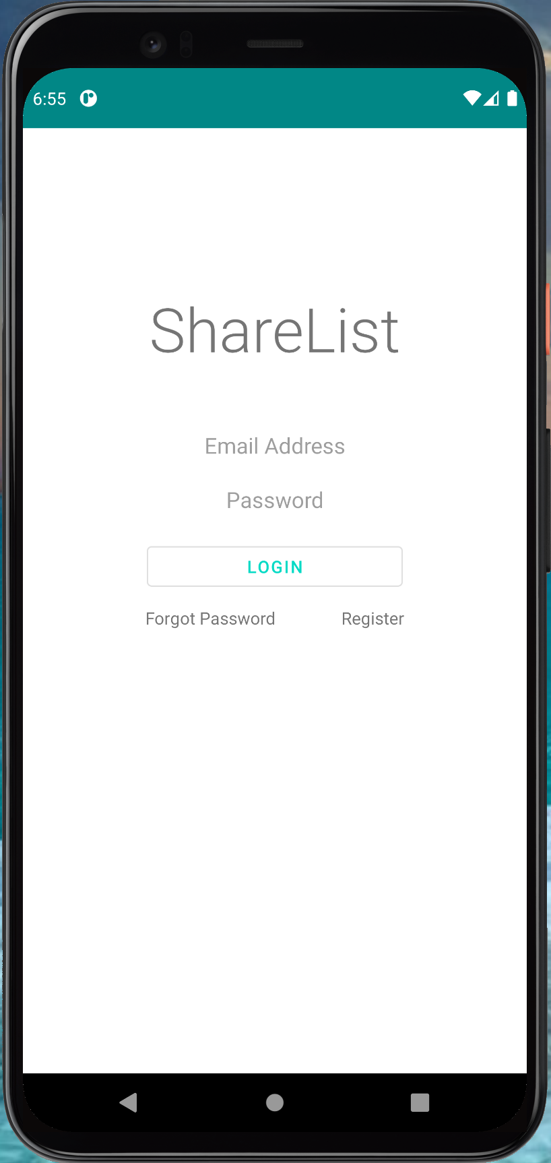
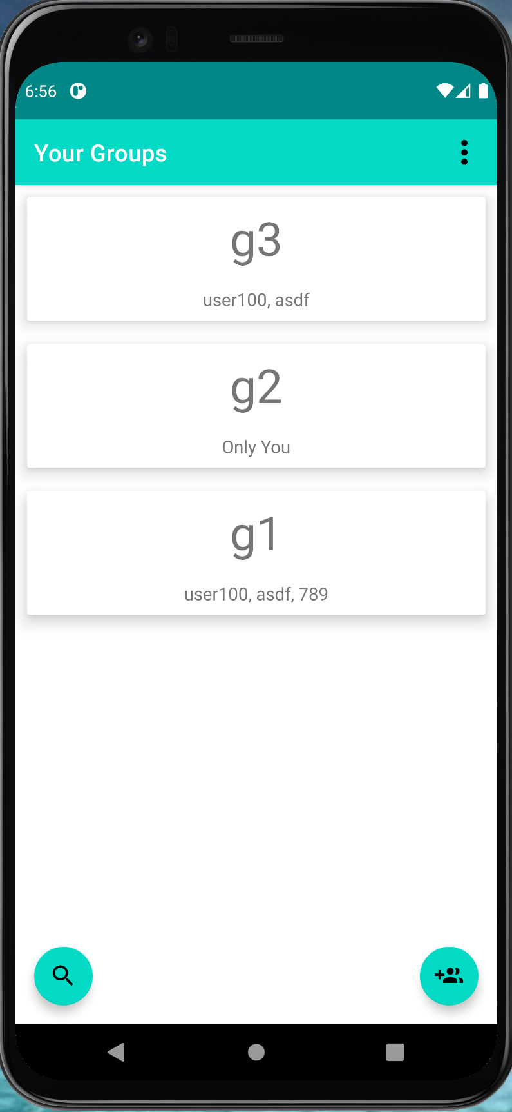
Expanded Use Case - Login
EUC1.2: Login
Precondition: This use case assumes that the user is seeing the Login page and is a registered user.
Actor: User | System: ShareList
1. TUCBW the user enters the details and clicks on the Login button. 3) TUCEW the user successfully logs in. | 0. System displays the Login page. *2. System checks the credentials entered by user: a) If the credentials are correct, the users 'Your Groups' page will be displayed. b) If incorrect, the system will display an “Incorrect username/password” message.
Postcondition: The user will be able to access the features of the app.

Slide 14
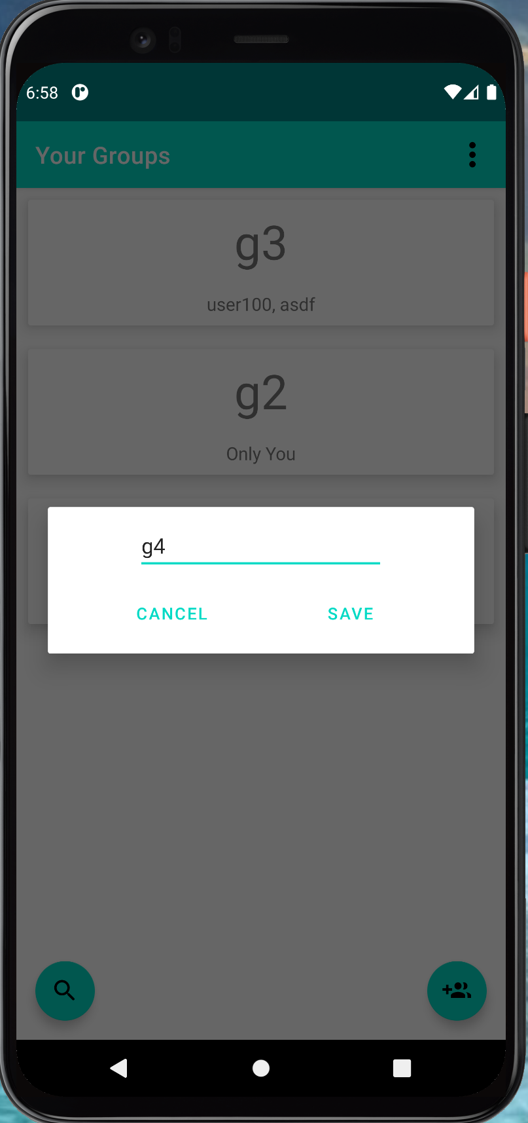
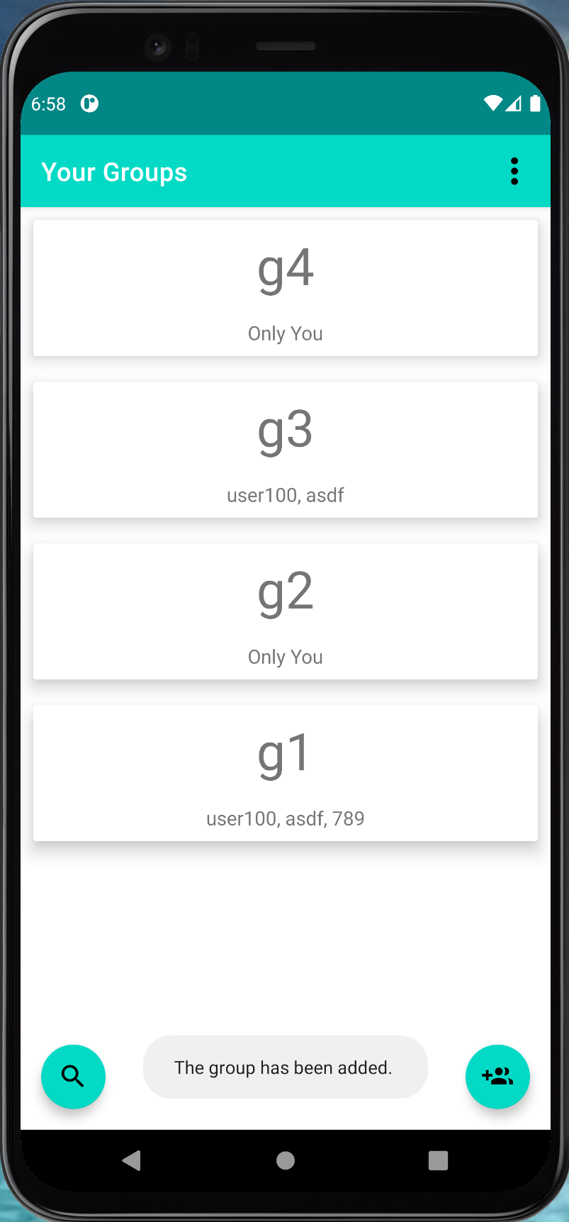
Expanded Use Case - Create Group
EUC5: Create Group
Precondition: This use case requires that the user is logged in to the ShareList App, and seeing the 'Create Group' activity.
Actor: User | System: ShareList
1. TUCBW user clicking on the Create Group button. 3. The user fills in the text field and clicks the save button. 5. TUCEW the user sees a confirmation “The group has been created”. | 0. System displays the Create Group activity. 2. System displays text field to enter group name. *4. System checks for errors and processes the save request.
Postcondition: The group is created, stored in the database, and available to be acted upon immediately.

Slide 15
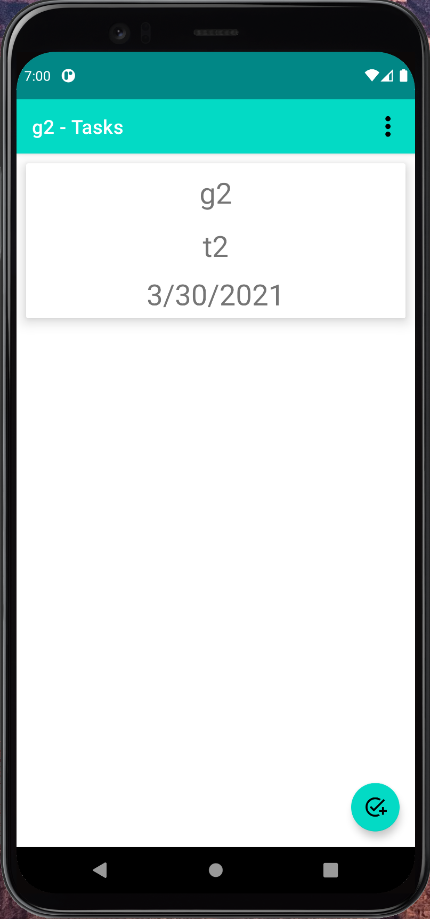
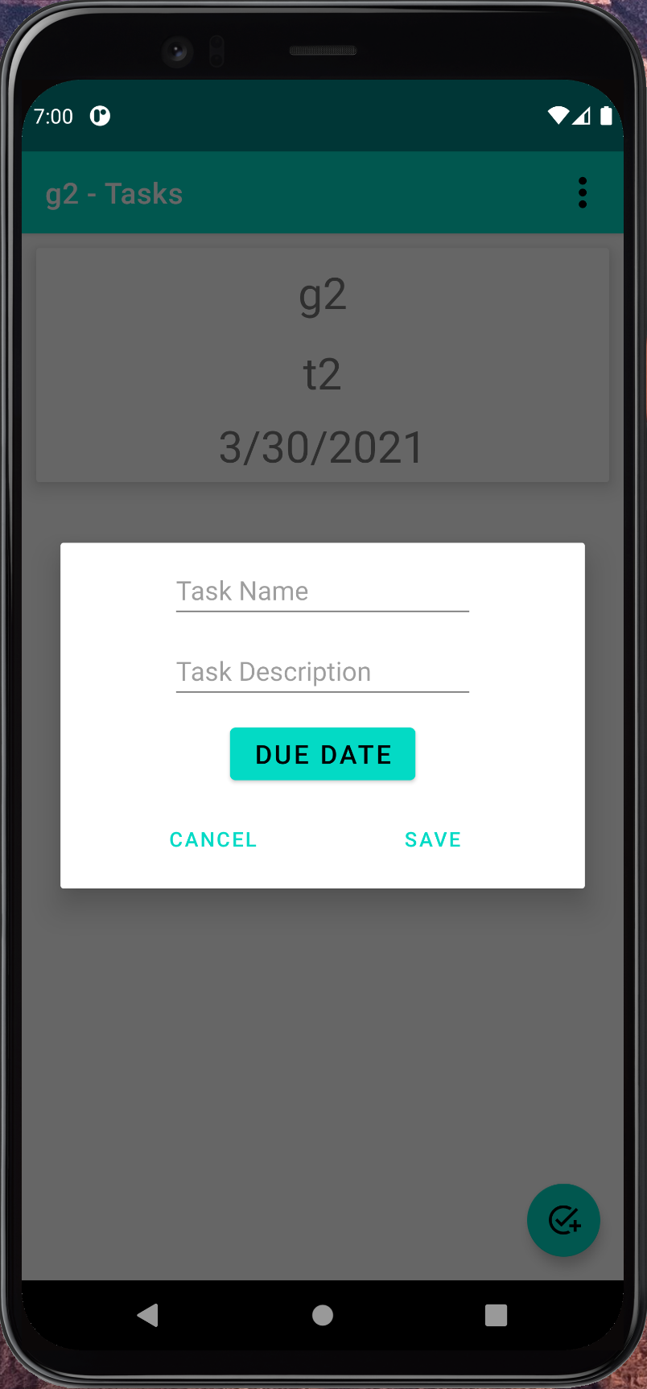
Expanded Use Case - Add Task
EUC2.1: Add Tasks
Precondition: This use case requires that the user is logged in and is an admin of the group.
Actor: Group Admin | System: ShareList
1. TUCBW group admin clicking on the Add Task button. 3. The group admin enters the information and clicks on the Save button. 5. TUCEW the group admin sees a confirmation “The task has been added” on the app | 0. System displays the Add task button. 2. System prompts the group admin to enter the Task name, Task Description and Due date. *4. System checks for errors, and processes the save request.
Postcondition: The task is created successfully and stored in the database.

Slide 16
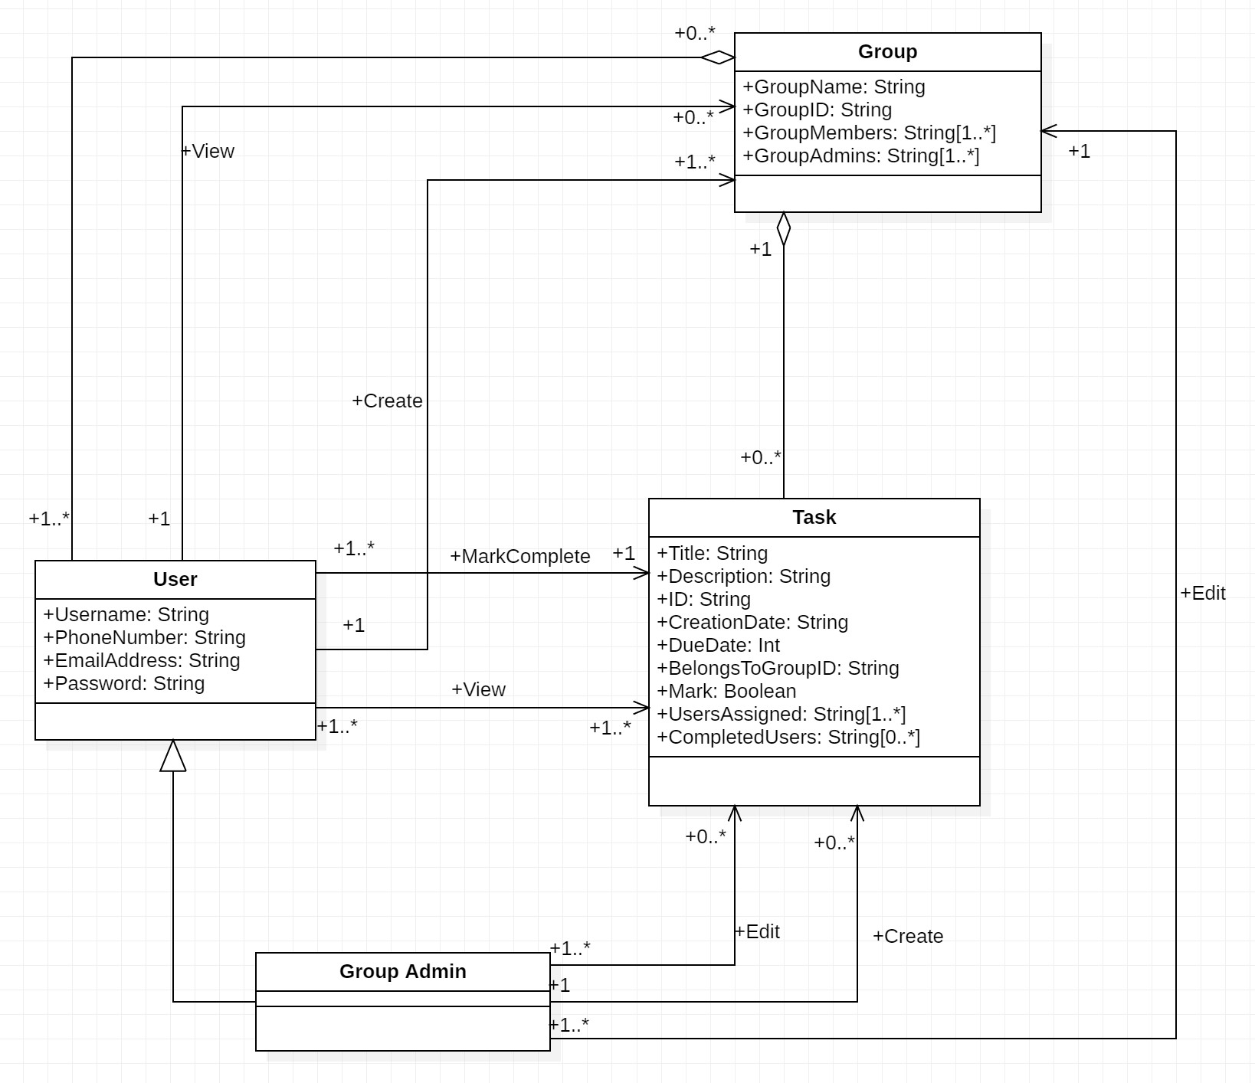
Updated Domain Diagram

Slide 17
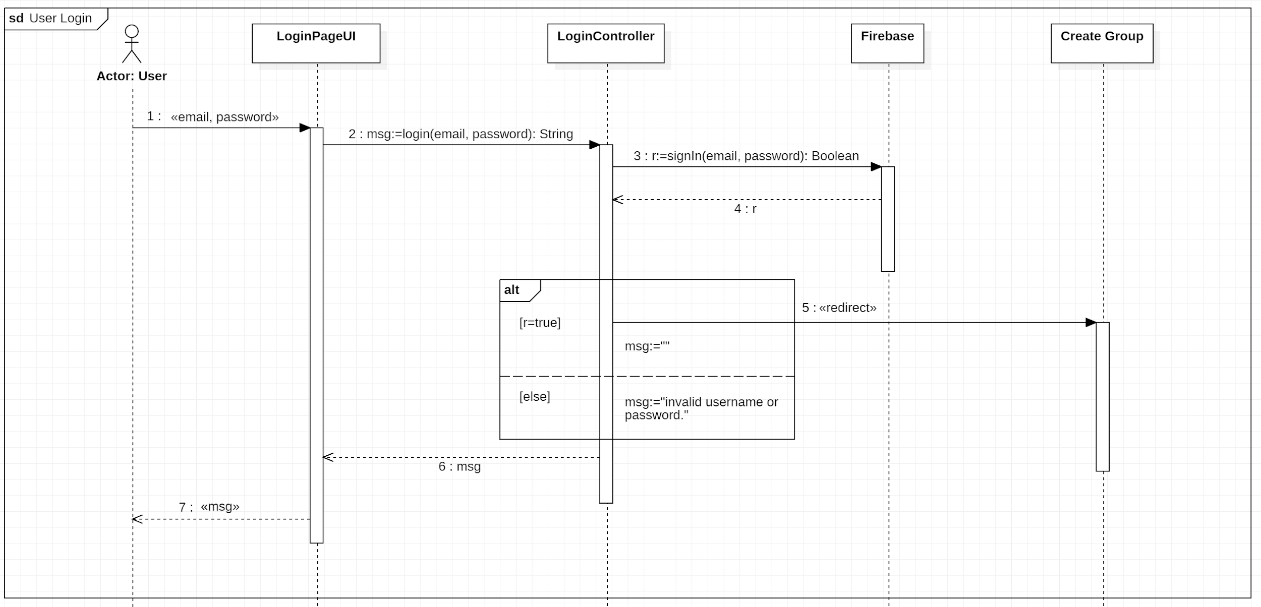
Sequence Diagram - Login

Slide 18
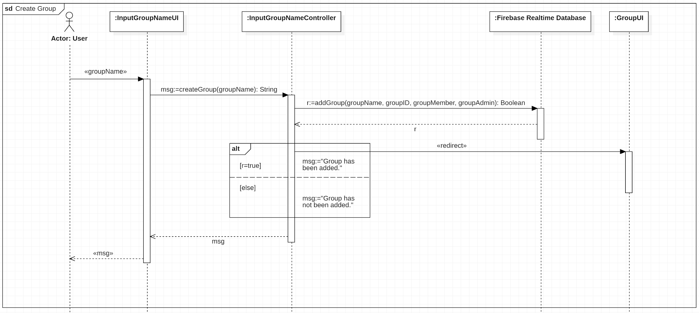
Sequence Diagram - Create Group

Slide 19
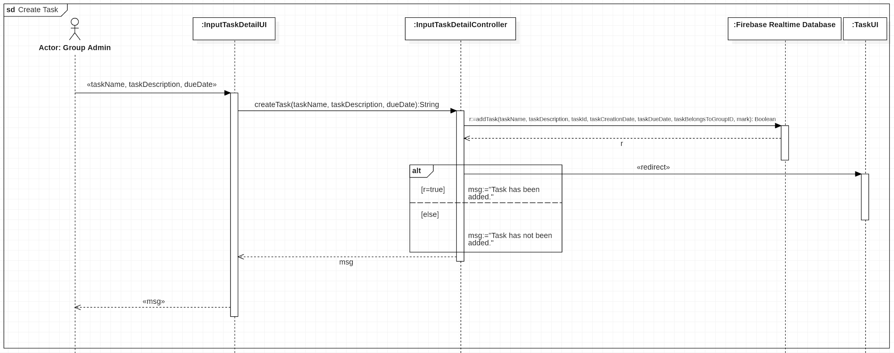
Sequence Diagram - Add Task

Slide 20
Updated Task List
Assigned to... | Iteration 2 | Iteration 3 | Use Case
Mohammed & Anum | Add tasks. |  | 2
 |  | Remove tasks. | 2
Yanzhi & Yu | Register. |  | 1
 | Login. |  | 1
Mohammed & Anum | Manage task. |  | 2
 | Edit tasks. |  | 2
Hannan | Mark task as completed. |  | 4
 | Create groups. |  | 5
 | Search by keywords. |  | 6
 |  | Generate summary. | 7
Yanzhi & Yu | Log Off. |  | 1
 |  | Reset password. | 1
Mohammed & Anum | Assign tasks. |  | 3
 | Manage group. |  | 3
 | Add users. |  | 3
 | Remove users. |  | 3
 |  | Add admins. | 3
 |  | Delete groups. | 3
 |  | Edit groups. | 3

Slide 21
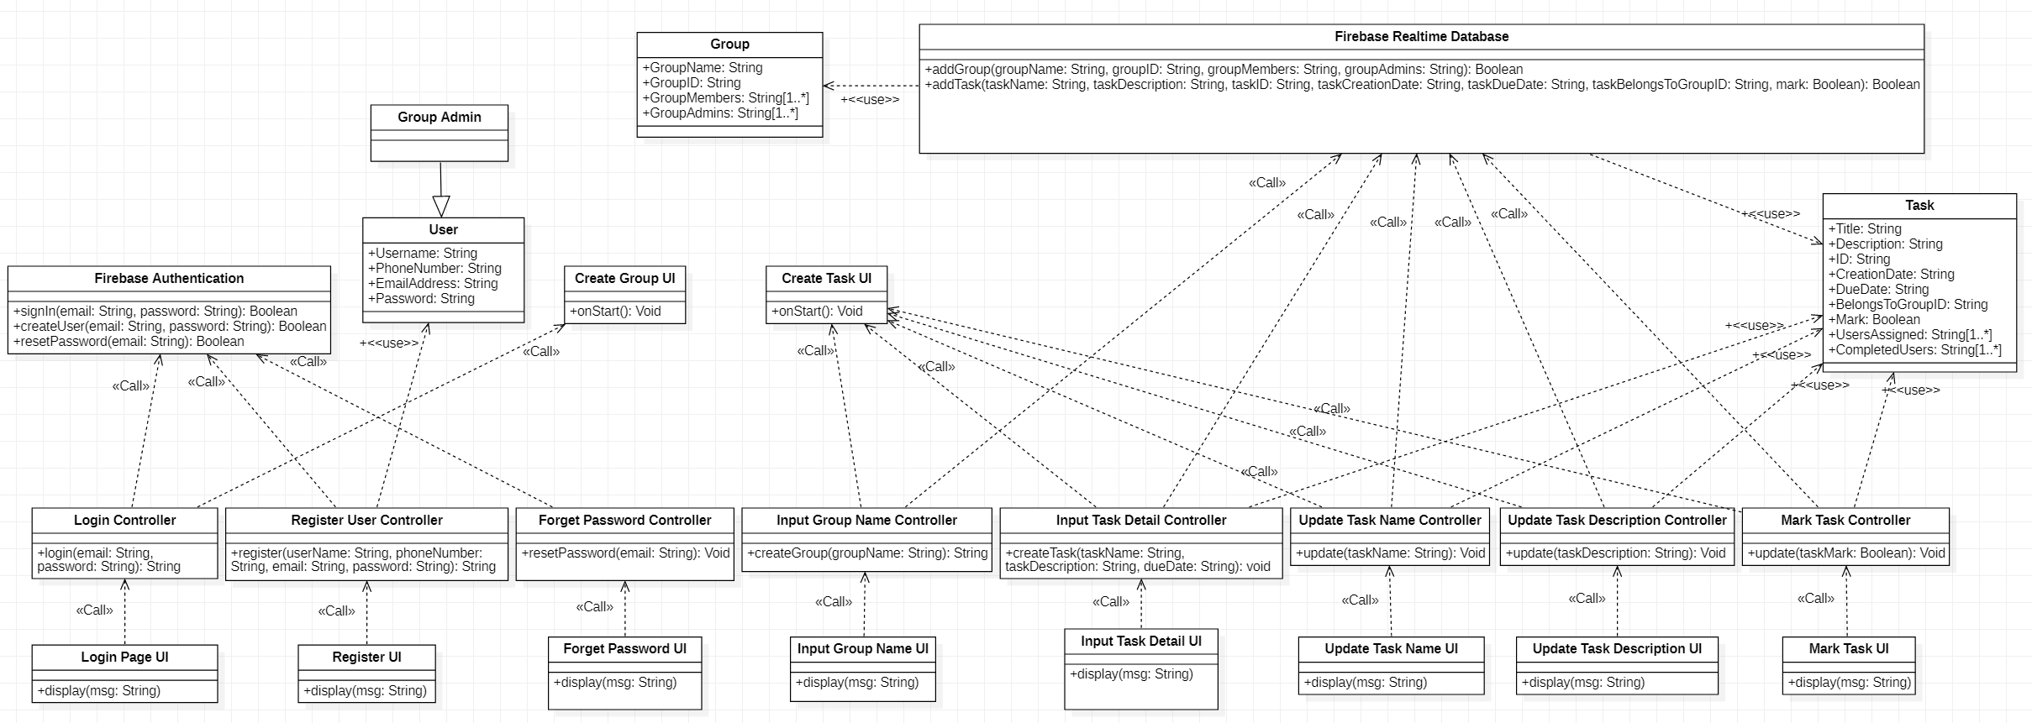
Design Class Diagram

Slide 22
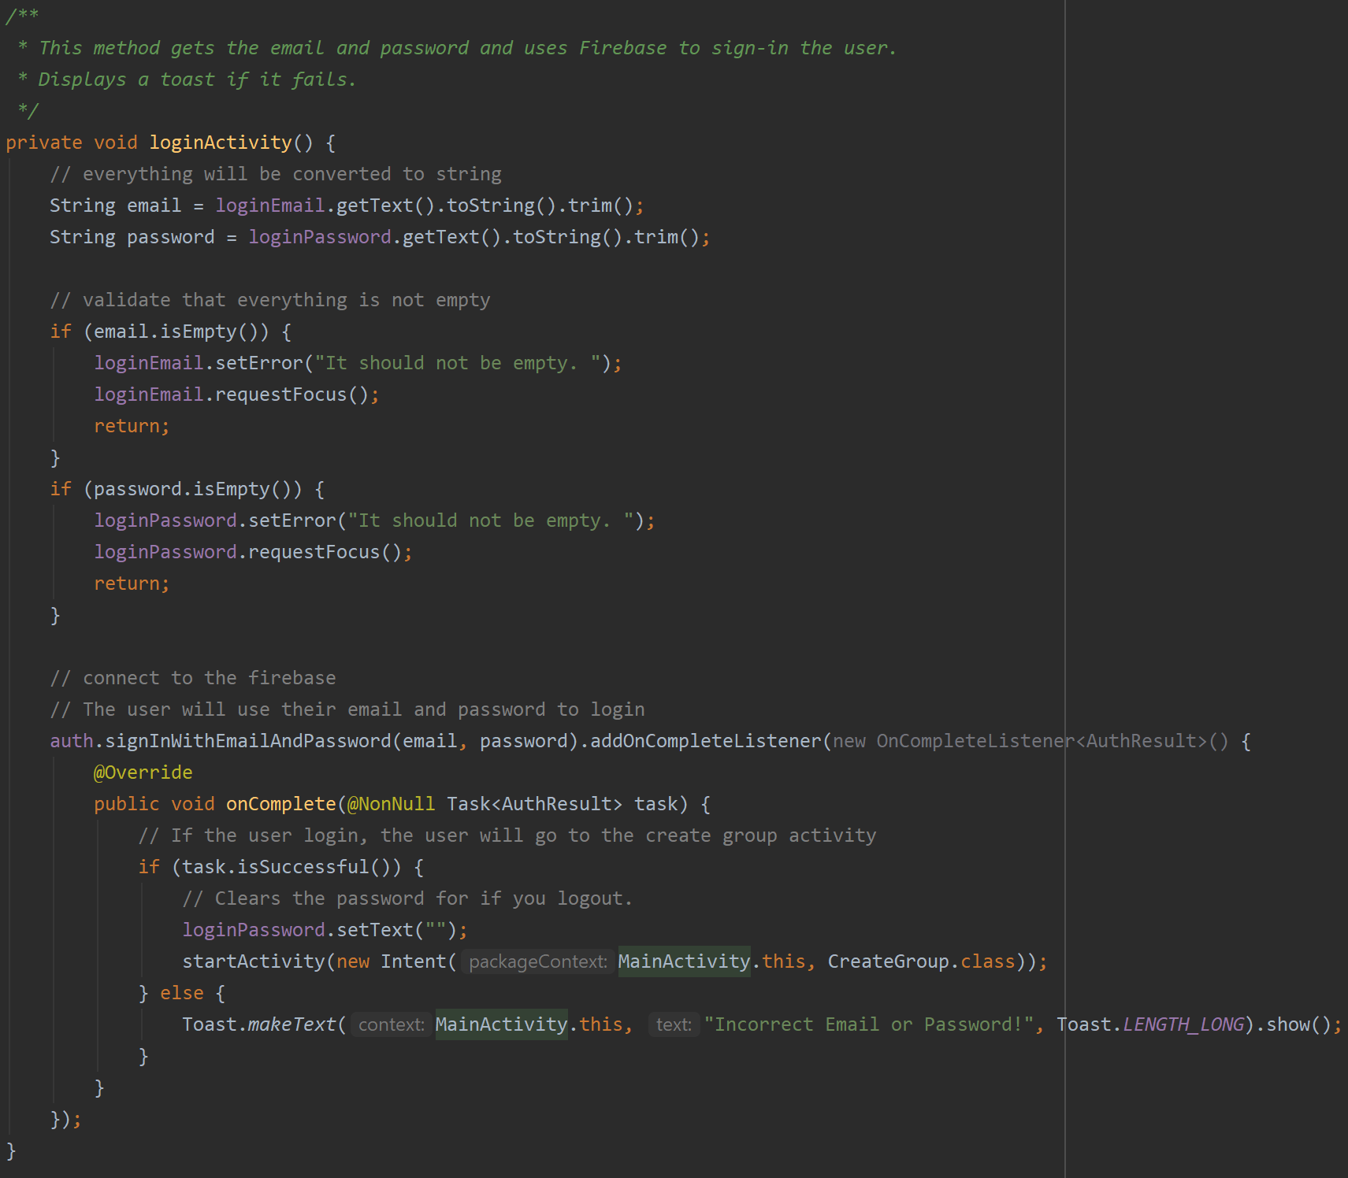
Code Snapshot - Login

Slide 23
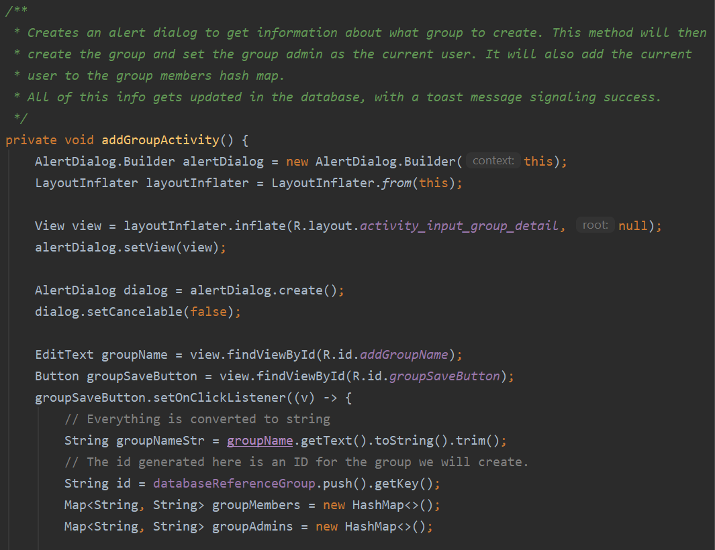
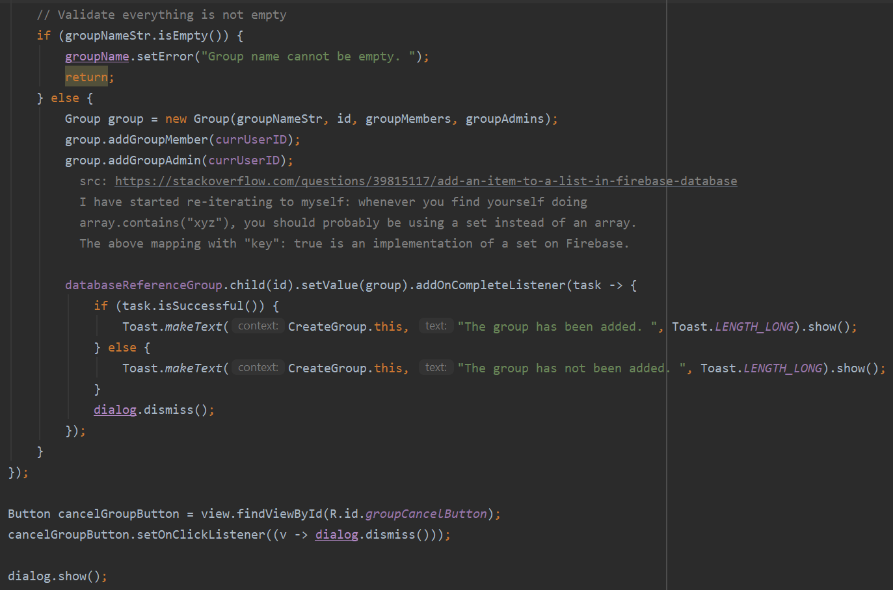
Code Snapshot - Create Group

Slide 24
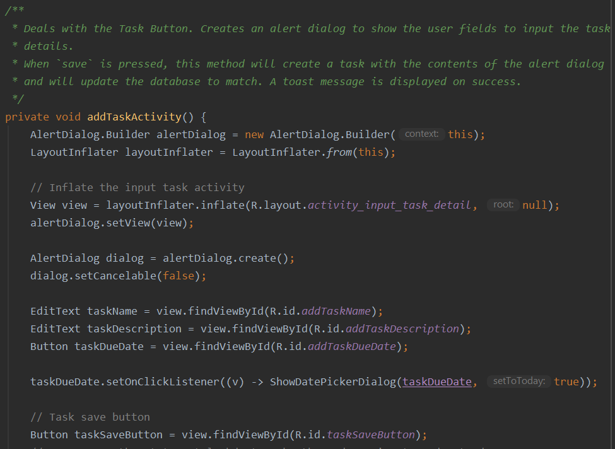
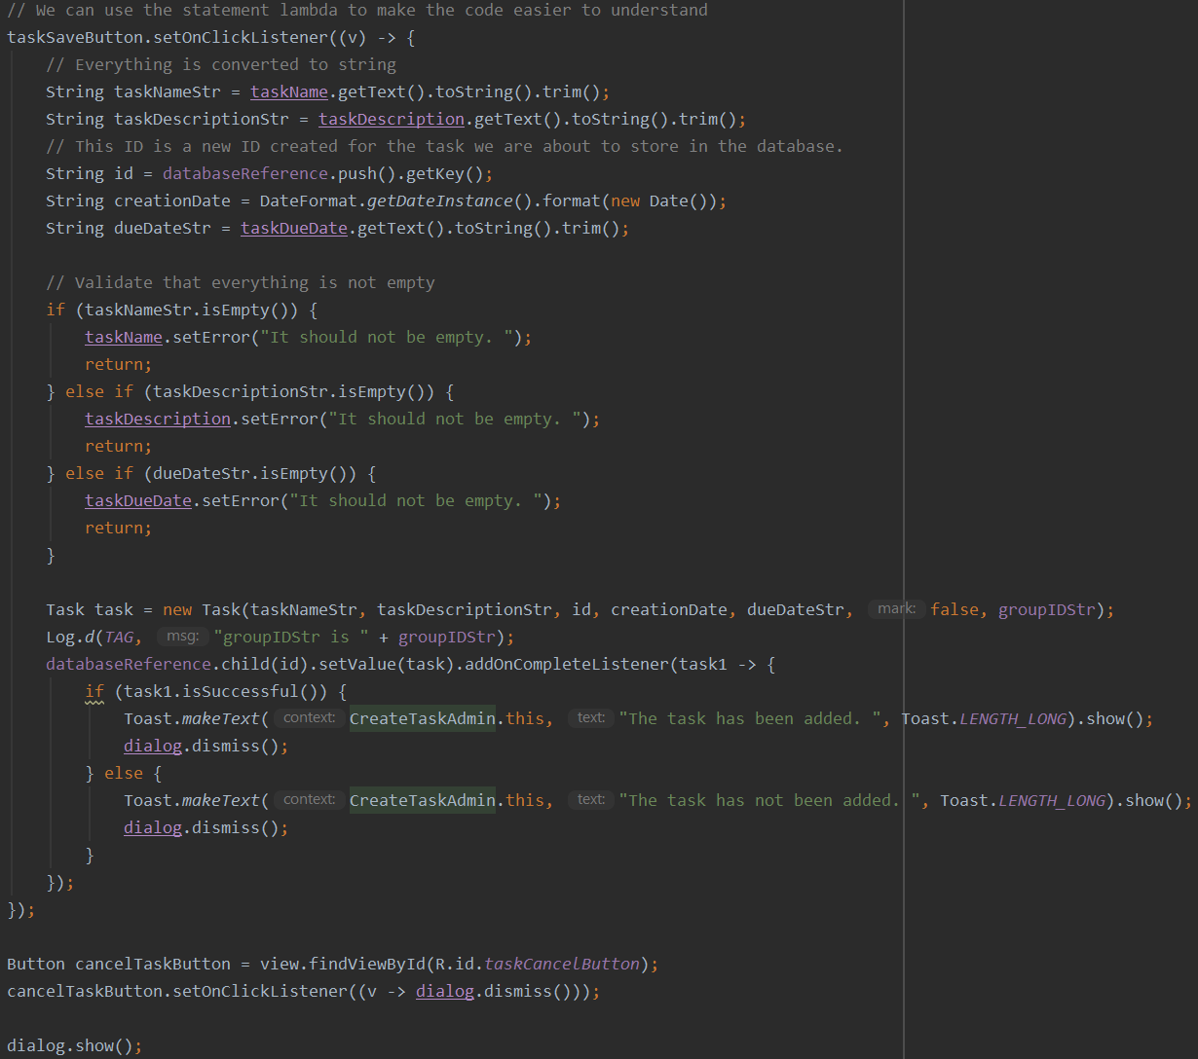
Code Snapshot - Add Task

Slide 25
Summary
Today we discussed the ShareList App
How it enables better collaboration between users.
The requirements and implementation approach.
Any updates to our app development.
Expanded UCs/User Interface Prototypes
Updated Domain Diagram/Sequence Diagrams
Updated Task List
Design Class Diagram
Brief Code Analysis

Slide 26
Thank You

